Slide 1


Harsh Rathod
20/05/2023

Slide 2

Outline
Executive Summary
Introduction
Methodology
Results
Conclusion
Appendix

Slide 3
Executive Summary
Summary of methodologies
This project follows these steps:
Data Collection
Data Wrangling
Exploratory Data Analysis
Interactive Visual Analytics
Predictive Analysis (Classification)

Slide 4
Summary of all results
This project produced the following outputs and
visualizations:
Exploratory Data Analysis (EDA) results
Geospatial analytics
Interactive dashboard
Predictive analysis of classification models

Slide 5
Introduction
Project background and context
Space X advertises Falcon 9 rocket launches on its website with a cost of 62 million dollars; other providers cost upward of 165 million dollars each, much of the savings is because Space X can reuse the first stage. Therefore, if we can determine if the first stage will land, we can determine the cost of a launch. This information can be used if an alternate company wants to bid against space X for a rocket launch. This goal of the project is to create a machine learning pipeline to predict if the first stage will land successfully.
Problems you want to find answers
What factors determine if the rocket will land successfully?
The interaction amongst various features that determine the success rate of a successful landing.
What operating conditions needs to be in place to ensure a successful landing program.

Slide 6

Section 1

Slide 7
Methodology
Executive Summary
Data collection methodology:
Data was collected using SpaceX API and web scraping from Wikipedia.
Perform data wrangling
One hot encoding data fields for ML and Dropping irrelevant columns.
Perform exploratory data analysis (EDA) using visualization and SQL
Scatter and bar graphs to show patterns between data
Perform interactive visual analytics using Folium and Plotly Dash
Perform predictive analysis using classification models
Build and evaluate classification models

Slide 8
Data Collection
The data was collected using various methods
Data collection was done using get request to the SpaceX API.
Next, we decoded the response content as a Json using .json() function call and turn it into a pandas dataframe using .json_normalize().
We then cleaned the data, checked for missing values and fill in missing values where necessary.
In addition, we performed web scraping from Wikipedia for Falcon 9 launch records with BeautifulSoup.
The objective was to extract the launch records as HTML table, parse the table and convert it to a pandas dataframe for future analysis.

Slide 9
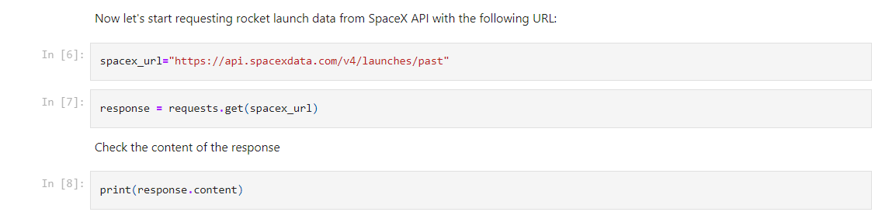
Data Collection – SpaceX API
We used the GET request to the SpaceX API to collect data. We then cleaned the data by removing any errors or inconsistencies. Finally, we did some basic data wrangling and formatting to make the data easier to use.
https://github.com/harshhin/IBM-Data-Science-Capstone/blob/main/Data%20Collection%20API.ipynb

Slide 10
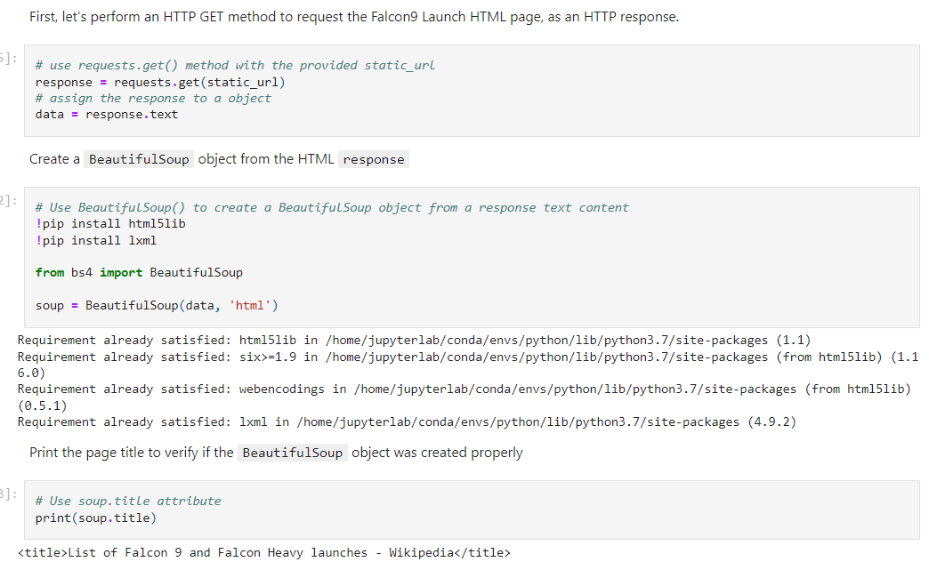
Data Collection - Scraping
We applied web scrapping to webscrap Falcon 9 launch records with BeautifulSoup
We parsed the table and converted it into a pandas dataframe
https://github.com/harshhin/IBM-Data-Science-Capstone/blob/main/Data%20Collection%20with%20Web%20Scraping.ipynb

Slide 11

Data Wrangling
We conducted exploratory data analysis and derived the training labels based on the outcomes. We analyzed the frequency of launches at each site as well as the number and occurrence of different orbits. We transformed the outcome column into a landing outcome label and exported the results to a CSV file.
https://github.com/harshhin/IBM-Data-Science-Capstone/blob/main/Data%20Wrangling.ipynb

Slide 12
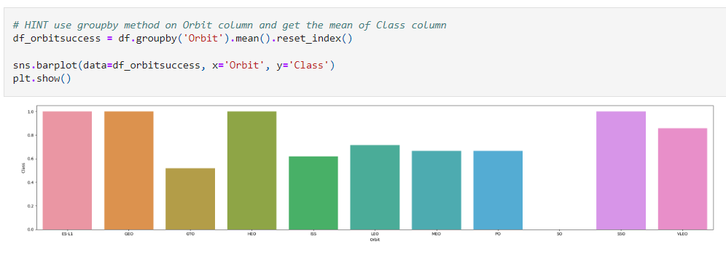
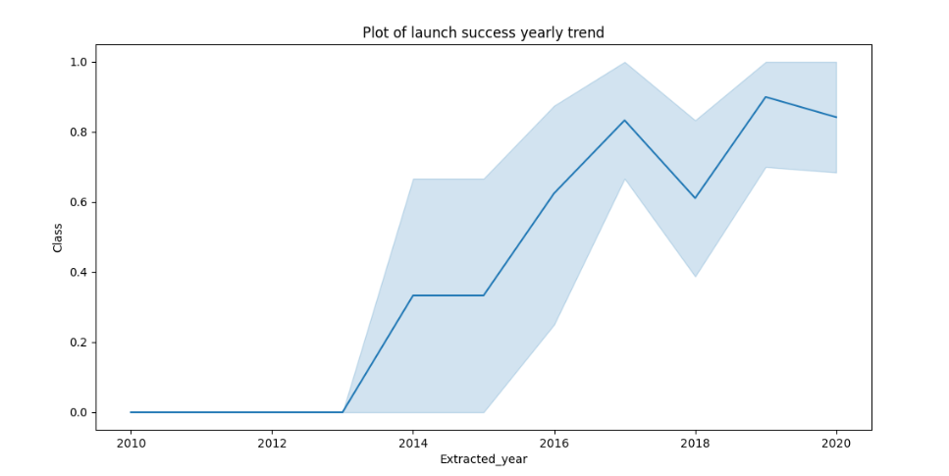
EDA with Data Visualization
https://github.com/harshhin/IBM-Data-Science-Capstone/blob/main/EDA%20with%20Data%20Visualization.ipynb
Bar Graph
Line Drawn

Slide 13
EDA with SQL
The SpaceX dataset was loaded into a PostgreSQL database seamlessly within the Jupyter Notebook environment. Through the utilization of SQL queries, exploratory data analysis (EDA) was performed to extract valuable insights from the data. The following specific queries were executed to unveil important information:
The names of unique launch sites in the space mission.
The total payload mass carried by boosters launched by NASA (CRS)
The average payload mass carried by booster version F9 v1.1
The total number of successful and failure mission outcomes
The failed landing outcomes in drone ship, their booster version and launch site names
The link to the notebook is https://github.com/harshhin/IBM-Data-Science-Capstone/blob/main/SQL%20Notebook%20for%20Peer%20Assignment.ipynb

Slide 14
Build an Interactive Map with Folium
Launch site mapping: All launch sites were marked on a Folium map, and map objects like markers, circles, and lines were added to represent the success or failure of launches at each site.
Classifying launch outcomes: The launch outcomes, categorized as failure or success, were assigned class labels of 0 and 1, respectively. This classification allowed for easier analysis and visualization of the data.
Color-labeled marker clusters: Marker clusters on the map were color-coded based on the launch outcomes (success or failure). This visualization technique helped identify launch sites with relatively high success rates by observing the clustering patterns.
Calculation of distances: Distances between a launch site and its neighboring locations were calculated. This allowed for further analysis and exploration of spatial relationships between launch sites and their proximities.
https://github.com/harshhin/IBM-Data-Science-Capstone/blob/main/Interactive%20Visual%20Analytics%20with%20Folium%20lab.ipynb

Slide 15
Build a Dashboard with Plotly Dash
An interactive dashboard was created using Plotly Dash to visualize the data. The dashboard includes the following plots:
Pie charts: Pie charts were used to display the total launches for specific launch sites, providing a visual representation of the distribution of launches across different sites.
Scatter graph: A scatter graph was plotted to examine the relationship between the launch outcome and payload mass (in kilograms) for different booster versions. This plot allows for the identification of any patterns or trends between the outcome and payload mass.
GitHub link is https://github.com/harshhin/IBM-Data-Science-Capstone/blob/main/spacex_dash_app.py

Slide 16
Predictive Analysis (Classification)
The data was loaded into the notebook using the numpy and pandas libraries. Afterward, the data was transformed, and a split was performed to separate it into training and testing sets.
Different machine learning models were built, and hyperparameters were tuned using GridSearchCV, a method for systematically searching the hyperparameter space. The accuracy metric was utilized to evaluate the performance of the models.
To enhance the models, feature engineering techniques and algorithm tuning were employed. These steps aimed to improve the predictive capabilities of the models by selecting relevant features and optimizing the algorithms' settings.
Through the evaluation process, the best performing classification model was identified based on its accuracy score.
GitHub link is https://github.com/harshhin/IBM-Data-Science-Capstone/blob/main/Machine%20Learning%20Prediction%20lab.ipynb

Slide 17
Results
Exploratory data analysis results
Interactive analytics demo in screenshots
Predictive analysis results

Slide 18

Section 2

Slide 19
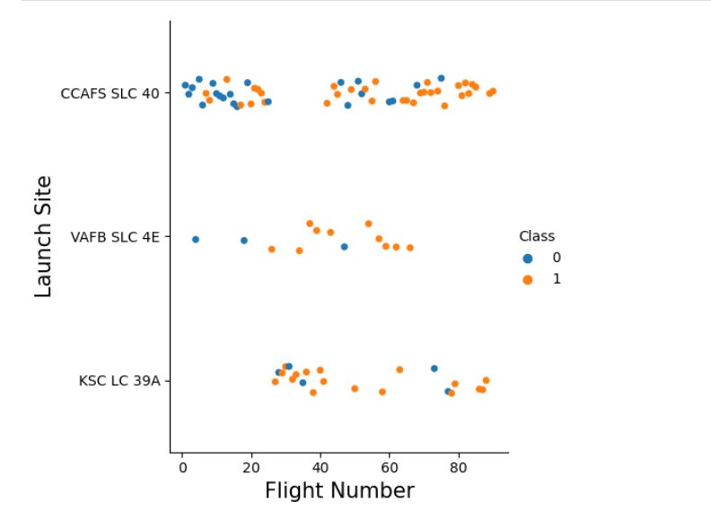
Flight Number vs. Launch Site
Number vs. Launch Site

Slide 20
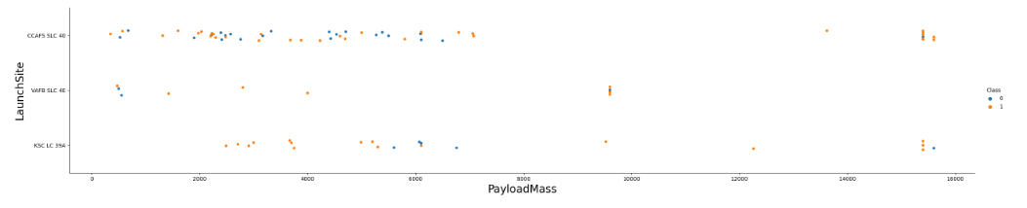
Payload vs. Launch Site
Payload vs. Launch Site

Slide 21
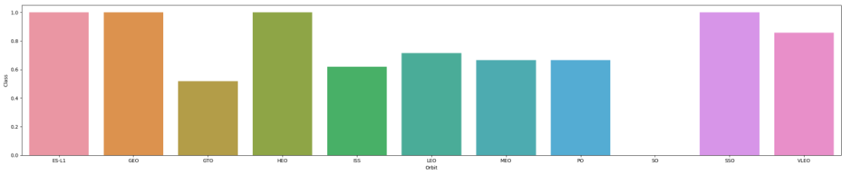
Success Rate vs. Orbit Type
From the plot we can see Success rate of all type of Orbit.

Slide 22
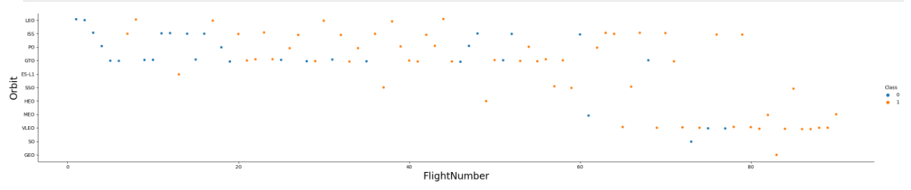
Flight Number vs. Orbit Type
The plot below shows the Flight Number vs. Orbit type. We observe that in the LEO orbit, success is related to the number of flights whereas in the GTO orbit, there is no relationship between flight number and the orbit.

Slide 23
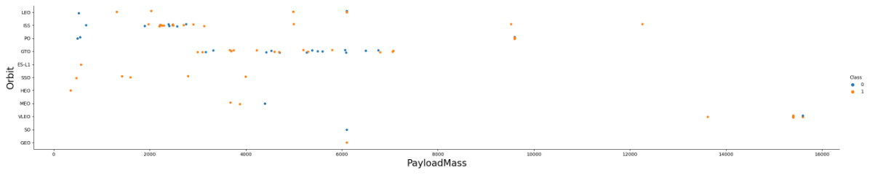
Payload vs. Orbit Type
We can observe that with heavy payloads, the successful landing are more for PO, LEO and ISS orbits.

Slide 24
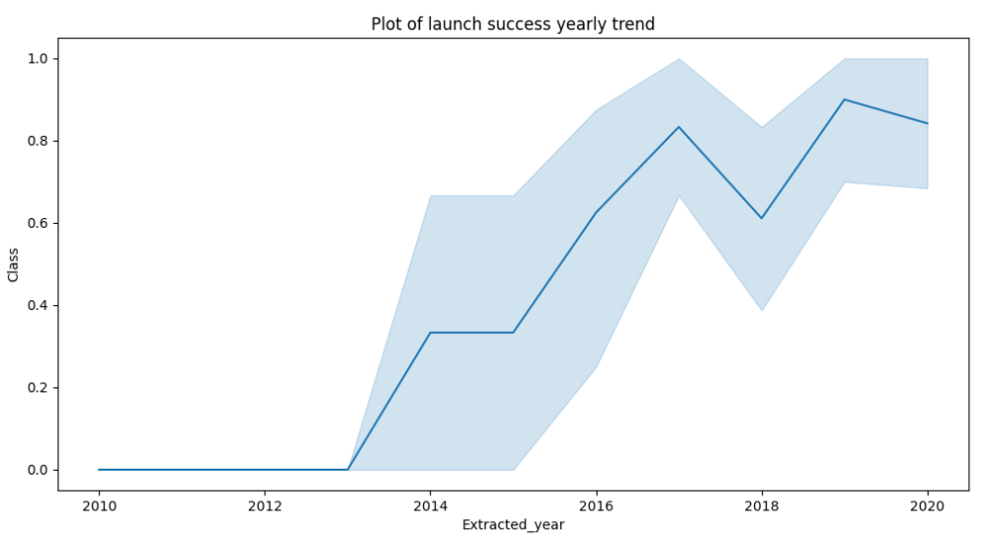
Launch Success Yearly Trend
From the plot, we can observe that success rate since 2013 kept on increasing till 2020. While there is slightly Decline between 2017 to 2018.

Slide 25

All Launch Site Names
We used the key word DISTINCT to show only unique launch sites from the SpaceX data.

Slide 26

Launch Site Names Begin with 'CCA'
We used the query below to display 5 records where launch sites begin with `CCA`

Slide 27

Total Payload Mass
We calculated the total payload carried by boosters from NASA as 45596 using the query below

Slide 28

Average Payload Mass by F9 v1.1
We calculated the average payload mass carried by booster version F9 v1.1 as 2928.4

Slide 29

First Successful Ground Landing Date
We observed that the dates of the first successful landing outcome on ground pad was 22nd December 2015

Slide 30

Successful Drone Ship Landing with Payload between 4000 and 6000
We used the WHERE clause to filter for boosters which have successfully landed on drone ship and applied the AND condition to determine successful landing with payload mass greater than 4000 but less than 6000

Slide 31

Total Number of Successful and Failure Mission Outcomes
We used wildcard like ‘%’ to filter for WHERE MissionOutcome was a success or a failure.

Slide 32

Boosters Carried Maximum Payload
We determined the booster that have carried the maximum payload using a subquery in the WHERE clause and the MAX() function.

Slide 33

2015 Launch Records
We used a combinations of the WHERE clause, LIKE, AND, and BETWEEN conditions to filter for failed landing outcomes in drone ship, their booster versions, and launch site names for year 2015

Slide 34

Rank Landing Outcomes Between 2010-06-04 and 2017-03-20
Selection: Landing outcomes and the count of landing outcomes were chosen from the dataset.
Filtering: The WHERE clause was used to filter the landing outcomes for the period between 2010-06-04 and 2010-03-20.
Grouping: The GROUP BY clause was applied to group the landing outcomes based on their values.
Ordering: The ORDER BY clause was used to sort the grouped landing outcomes in descending order.

Slide 35

Section 3

Slide 36

All launch sites global map markers

Slide 37

Markers showing launch sites with color labels

Slide 38

Launch Site distance to landmarks

Slide 39

Section 4

Slide 40

Launch success count for all sites, in a pie chart
We can see that KSC LC-39A had the most successful launches from all the sites

Slide 41

Pie chart showing the Launch site with the highest launch success ratio
KSC LC-39A achieved a 76.9% success rate while getting a 23.1% failure rate

Slide 42

Scatter plot of Payload vs Launch Outcome for all sites, with different payload selected in the range slider
We can see the success rates for low weighted payloads is higher than the heavy weighted payloads

Slide 43

Section 5

Slide 44
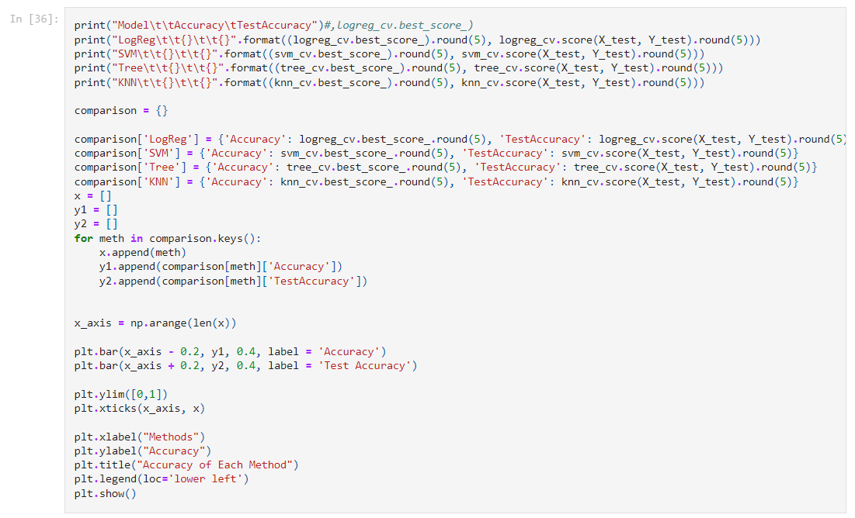
Classification Accuracy
Result is on next slide

Slide 45
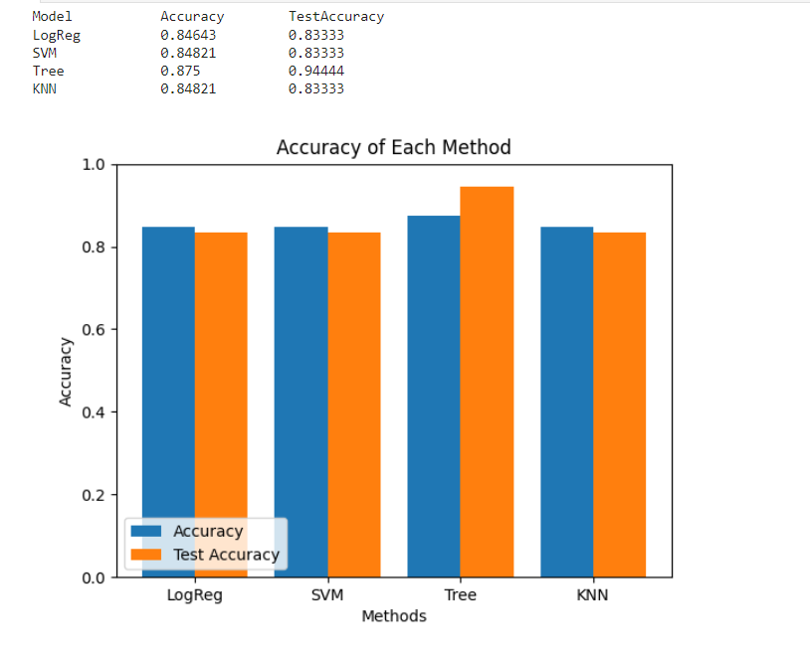
Classification Accuracy

Slide 46
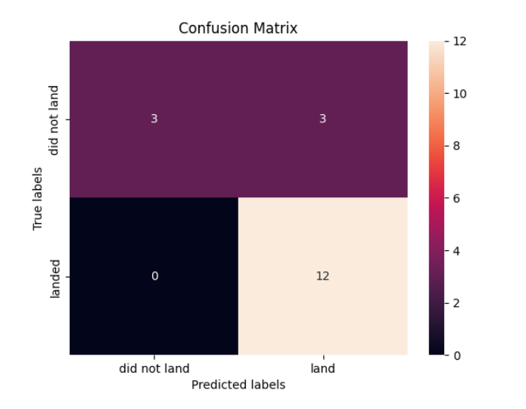
Confusion Matrix
The confusion matrix for the decision tree classifier shows that the classifier can distinguish between the different classes. The major problem is the false positives .i.e., unsuccessful landing marked as successful landing by the classifier.

Slide 47
Conclusions
We conclude that
Flight amount and success rate: There is a positive correlation between the flight amount at a launch site and the success rate. Sites with larger flight amounts tend to have higher success rates.
Increase in success rate: From 2013 to 2020, there was a noticeable increase in the overall launch success rate.
Successful orbits: Orbits such as ES-L1, GEO, HEO, SSO, and VLEO exhibited the highest success rates among all the orbits.
Successful launches at KSC LC-39A: KSC LC-39A was identified as the launch site with the highest number of successful launches compared to other sites.
Best machine learning algorithm: The Decision Tree Classifier was determined to be the most effective machine learning algorithm for this specific task.

Slide 48


